Slide 1
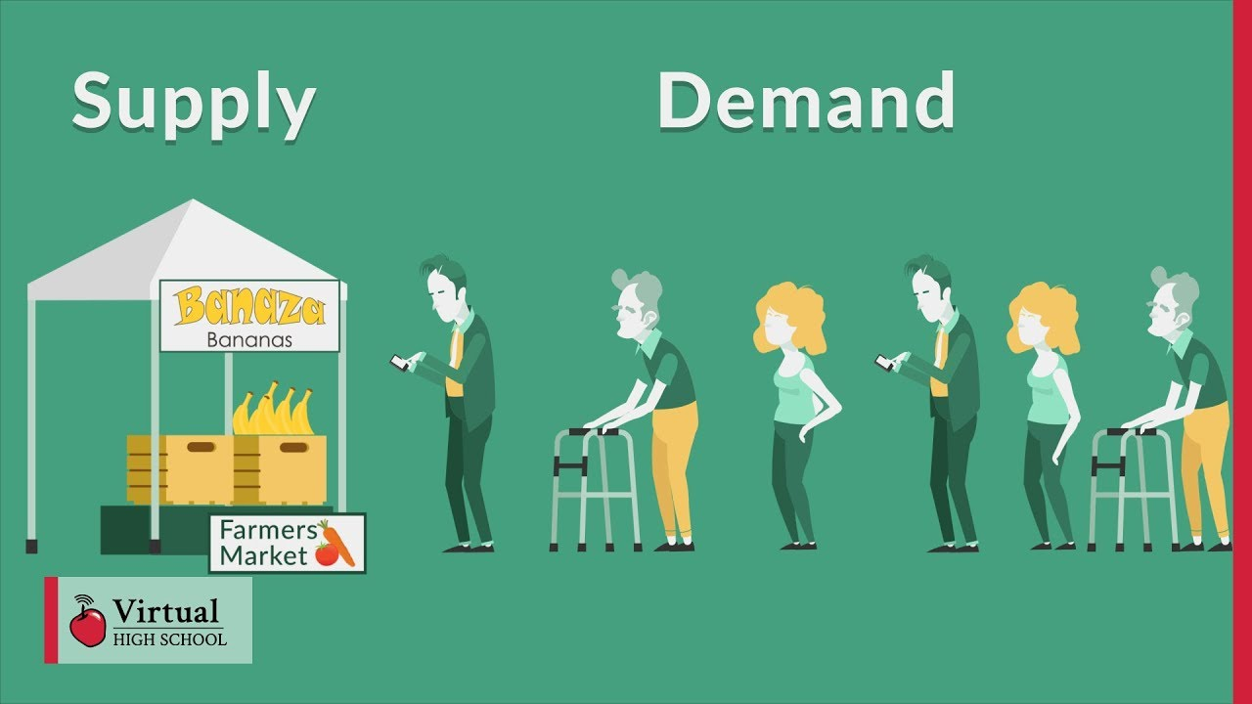
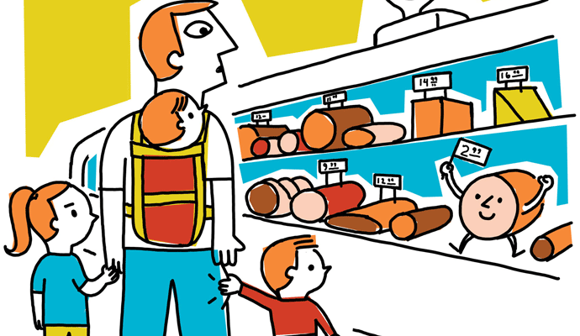
By Dr. RAVI KUMAR GUPTA
ENGINEERING AND MANAGERIAL ECONOMICS, UNIT-II

Slide 2
Table of content
Concepts of Demand and Supply:
Demand Analysis
Law of Demand
Determinants of Demand
Elasticity of Demand: Price, Income and cross Elasticity
Uses of concept of elasticity of demand in managerial decision
Demand Forecasting: Meaning, significance and methods of demand forecasting,
Law of Supply
Determinants of supply
Elasticity of supply

Slide 3
Demand
Demand refers to the willingness and ability of consumers to purchase a given quantity of a good or service at a given price, at a point of time and at given place.
In economics, demand is formally defined as ‘effective’ demand meaning that it is a consumer want or a need supported by an ability to pay – namely a budget derived from disposable income. Income provides individuals with a purchasing power which they exercise in a market through effective demand.
Wish to buy | Willingness to pay | Ability to pay | =Demand
yes | No | No | No
Yes | Yes | No | No
Yes | Yes | Yes | Yes

Slide 4
Clarification…..
Here consideration of possibility of sales of goods is important because we always see the demand from the producers perspective. So any desire of consumer which can not be converted into sales will not be amounted as demand and hence not relevant.
means any ‘desire or willingness to buy’ a product if not supported by ‘willingness to pay’ and ‘ability to pay’ will not be considered as demand.
So, Demand= Wish to buy + Willingness to pay + Ability to pay
Further, Demand can be specify only at given price, for give period of time and for given place.
Example, if we ask, what is the demand of BMW car? The question does not clarifies demand at which price, for which year or month, in which country or state.
The complete question will be, What will be demand of BMW in 2021, in India at a price of Rs. 5 millions?

Slide 5
Demand Function
A mathematical expression of relationship between quantity demanded of the commodity and its determinants is known as the demand function. Explained below.
Qx = f(Px, Py, Pz, I, T, etc.)
Where,
Qx= Quantity Demanded of X
Px= Price of commodity X
Py= Price of Substitute goods
Pz= Price of complementary goods
I = Income of the Customer
T = Taste of the consumer

Slide 6
Demand Schedule
Demand schedule is a tabular statement showing various quantities of a commodity being demanded at various levels of price, during a given period of time. It shows the relationship between price of the commodity and its quantity demanded.
A demand schedule can be determined both for individual buyers and for the entire market. So, demand schedule is of two types:
1. Individual Demand Schedule:- Individual demand schedule refers to a tabular statement showing various quantities of a commodity that a consumer is willing to buy at various levels of price, during a given period of time.
2. Market Demand Schedule:- Market demand schedule refers to a tabular statement showing various quantities of a commodity that all the consumers are willing to buy at various levels of price, during a given period of time. It is the sum of all individual demand schedules at each and every price.

Slide 7
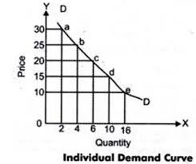
Demand Curve
Demand curve is the graphical representation of the demand schedule. Demand curve is obtained by plotting a demand schedule on a graph. As discussed earlier, demand curve slopes downward from left to right. It has a negative slope. It shows there is inverse relationship between price and quantity demanded of a commodity.

Slide 8
TYPES OF DEMAND
1. Direct and indirect demand:
Producers’ goods and consumers’ goods: demand for goods that are directly used for consumption by the ultimate consumer is known as direct demand (example: Demand for T shirts).
On the other hand demand for goods that are used by producers for producing goods and services. (example: Demand for cotton by a textile mill)
2. Derived demand and autonomous demand:
When a produce derives its usage from the use of some primary product it is known as derived demand. (example: demand for tyres derived from demand for car)
Autonomous demand is the demand for a product that can be independently used. (example: demand for a washing machine)

Slide 9
Continued…..
3. Durable and non durable goods demand:
Durable goods are those that can be used more than once, over a period of time (example: Microwave oven)
Non durable goods can be used only once (example: Band-aid)
4. Firm and industry demand:
Firm demand is the demand for the product of a particular firm. (example: Dove soap)
The demand for the product of a particular industry is industry demand (example: demand for steel in India )

Slide 10
Continued…..
5. Total market and market segment demand:
A particular segment of the markets demand is called as segment demand (example: demand for 21 laptops by engineering students)
The sum total of the demand for laptops by various segments in India is the total market demand. (example: demand for laptops in India)
6. Short run and long run demand:
Short run demand refers to demand with its immediate reaction to price changes and income fluctuations.
Long run demand is that which will ultimately exist as a result of the changes in pricing, promotion or product improvement after market adjustment with sufficient time.

Slide 11
Continued…..
7. Joint demand and Composite demand:
When two goods are demanded in conjunction with one another at the same time to satisfy a single want, it is called as joint or complementary demand. (example: demand for petrol and two wheelers)
A composite demand is one in which a good is wanted for several different uses. ( example: demand for iron rods for various purposes)
8. Price demand, income demand and cross demand:
Demand for commodities by the consumers at alternative prices are called as price demand.
Quantity demanded by the consumers at alternative levels of income is income demand.
Cross demand refers to the quantity demanded of commodity ‘X’ at a price of a related commodity ‘Y’ which may be a substitute or complementary to X.

Slide 12
The Law of Demand
The law of demand states that, if all other factors remain equal,
“As the price increases, quantity demanded of that commodity decreases and as the price decreases the quantity demanded of the commodity increases.”
Px Dx
Px Dx
Where,
Px= Price of Commodity X
Dx= Demand of Commodity X

Slide 13
Assumptions to law of demand
There is no change in the tastes and preferences of the consumer;
The income of the consumer remains constant;
There is no change in customs;
There should not be any substitutes of the commodity;
There should not be any change in the prices of other products;
There should not be any change in the quality of the product; and
The habits of the consumers should remain unchanged.

Slide 14
Exceptions to the Law of Demand:
In certain cases, the demand curve slopes up from left to right, i.e., it has a positive slope. Under certain circumstances, consumers buy more when the price of a commodity rises, and less when price falls:
War:- If shortage is feared in anticipation of war, people “may start buying for building stocks or for hoarding even when the” price rises.
Depression:- During a depression, the prices of commodities are very low and the demand for them is also less. This is because of the lack of purchasing power with consumers.
Ignorance Effect:- Consumers buy more at a higher price under the influence of the “ignorance effect”, where a commodity may be mistaken for some other commodity, due to deceptive packing, label, etc.

Slide 15
Continued…..
(iv) Giffen Paradox:- If a commodity happens to be a necessity of life like wheat and its price goes up, consumers are forced to curtail the consumption of more expensive foods like meat and fish, and wheat being still the cheapest, food they will consume more of it.
Demonstration Effect (Veblen Goods):- If consumers are affected by the principle of conspicuous consumption or demonstration effect, they will like to buy more of those commodities which confer distinction on the possessor, when their prices rise. On the other hand, with the fall in the prices of such articles, their demand falls, as is the case with diamonds.

Slide 16
Determinants of Demand
The demand for a product is determined by different factors. The main demand determinants are price, income, price of related goods and advertising.
Therefore, demand is a multivariate relationship, i.e. it is determined by many factors simultaneously.
Determinants of Individual Demand: Let us discuss the variables which influence the individual demand.
1. Price of the Commodity:- Normally a larger quantity is demanded at a lower price that at a higher price. There is inverse relationship between the price and quantity demanded. This is called the law of demand.

Slide 17
Continued…..
Income of the Consumer:- The income of the consumer is another important variable which influences demand. The ability to buy a commodity depends upon the income of the consumer. When the income of the consumers increases, they buy more and when income falls they buy less.
3. Tastes and Preferences:- The demand for a product depends upon tastes and preferences of the consumers. If the con­sumers develop taste for a commodity they buy whatever may be the price.
4. Prices of Related Goods:-The related goods are generally substitutes and complementary goods. The demand for a product is also influenced by the prices of substitutes and complements. When a want can be satisfied by alternative similar goods they are called substitutes, such as coffee and tea. Whenever the price of one good and the demand for another are inversely related then the goods are said to be complementary, such as car and petrol.

Slide 18
Continued…..
Advertisement and Sales Propaganda:- Advertisement helps in increasing demand by informing the potential consumers about the avail­ability of the product, by showing the superiority of the product, and by influencing consumer choice against the rival products. The demand for products like detergents and cosmetics is mainly caused by advertisement.
Consumer’s Expectation:- A consumer s expectation about the future changes in price and income may also affect his demand. If a consumer expects a rise in prices he may buy large quantities of that particular commodity. Similarly, if he expects its prices to fall in future, he will tend to buy less at present. Similarly, expectation of rising income may induce him to increase his current consumption.

Slide 19
Continued…..
Determinants of Market Demand:- Market demand for a product refers to the total demand of all the buyers taken together. How much quantity the consumers in general would buy at a given period of time constitutes the total market demand for the product.
Price of the Product:- The law of demand states that if other things remain the same when price falls, demand increases and vice-versa.
Standard of Living and Spending Habits:- When people are accustomed to high standard of living their spending on comforts and luxuries also increase, that automatically increase the demand.
Distribution of Income Pattern:- If the distribution pattern of income is fair and equal the market demand for essential items tends to be greater.

Slide 20
Continued…..
The Scale of Preferences:- The market demand for a product is also affected by the scale of preference of buyers. If there is a shift in consumers’ preference from x to y, the demand for у tends to increase.
The Growth of Population:- The growth of population is also another important factor that affects the market demand. With the increase in population, people naturally demand more goods for their survival.
Social Customs and Ceremonies:- Social customs and ceremonies are usually celebrated collectively. They involve extra expenditure on certain items and thereby increase the demand.
Future Expectation:- People are not sure about their future, because future is uncertain. If the consumers expect a rise in prices of products, they buy more at present and preserve the same for the future, thereby the market demand would be affected.

Slide 21
Continued…..
Tax Rate:- High tax rate would generally mean a low demand for the goods. At certain times the government restricts the consumption of a commodity and uses the tax as a weapon.
Inventions and Innovations:- Inventions and innovations introduce new goods in the market. The consumers will have a strong tendency to purchase the new product. The preference over the new goods adversely affects the demand for the existing goods in the market.
Weather Conditions:- Seasonal factors also affect the demand. The demand for certain items purely depends on climatic and weather conditions. For example, the growing demand for cold drinks during the summer season and the demand for sweaters during the winter season.

Slide 22
Continued…..
Availability of Credit:- The purchasing power is influenced by the availability of credit. If there is availability of cheap credit, the consumers try to spend more on consumer durables thereby the demand for certain products increase.
Pattern of Saving:- If people begin to save more, their demand will decrease. It means the disposable income will be less to purchase the goods and services. On the contrary, if saving is less their demand will increase.
Demonstration Effect:- Demonstration effect helps to increase human wants. In underde­veloped countries, there is a desire in the minds of the people to imitate other people for conspicuous consumption and that is why they are not able to save. This change in the saving habits of the people is due to “contact effect”. The demonstration effect has a positive effect on the demand for comforts and luxury goods.

Slide 23

ELASTICITY OF DEMAND
If price changes we know the demand changes, but by how many percentage? Means what is the elasticity of that demand?
Elasticity measures the extent to which demand will change. Elasticity of demand is a measure to responsiveness of change in quantity demanded of a commodity due to change in a particular factor of demand.
Elasticity of Demand=
Elasticity can be of three types:
Price Elasticity of Demand
Income Elasticity of Demand
Cross Elasticity of Demand

Slide 24


1. PRICE ELASTICITY OF DEMAND
Price elasticity of demand measures the percentage change in quantity demanded caused by a percent change in price.
Price Elasticity of Demand (Ep)=
Ep=
Where,
∆q= Change in quantity demanded of commodity x
∆p= Change in price of commodity x
p= price of commodity x
q= quantity demanded of commodity x

Slide 25
Types of Price Elasticity of demand
ELASTIC DEMAND:- a change in price, results in a greater than proportional change in the quantity demanded. Ep>1
INELASTIC DEMAND:- a change in price results in a less than proportional change. Ep<1
UNITARY ELASTIC DEMAND :- a change in price results in n equal proportional change. Ep=1
PERFECTLY ELASTIC DEMAND :- demand changes even when price remains unchanged. Ep=∞
PERFECTLY INELASTIC DEMAND ;- change in price does not result in any change. Ep=0

Slide 26


Income elasticity of demand
The percentage change in quantity demanded due to percentage change in income is called income elasticity of demand. Income elasticity of demand measures the responsiveness of demand for a good to change in income of consumer.
Income Elasticity of Demand (Ey) =
Ey=
Where,
∆q= change in quantity demanded of commodity x
∆y= change in the income of the consumer
q= quantity demanded of commodity x
y= income of the consumer

Slide 27
Types of Income elasticity of demand
1. POSITIVE INCOME ELASTICITY
A rise in income will cause a rise in demand , A fall in income will cause a fall in demand. Ey>0
2. NEGATIVE INCOME ELASTICITY
An increase in income will result in a decrease in demand, A decrease in income will result in a rise in demand. (ex. Inferior good) Ey<0
3. ZERO INCOME ELASTICITIES
This occurs when a change in income has NO effect on the demand for goods. (ex. A rise of 5% income will leave the Demand for salt unchanged). Ey=0

Slide 28


Cross Elasticity of demand
There is cross elasticity of demand when demand for a commodity changes due to a change in the price of another related commodity. In fact cross elasticity of demand measures the change in demand of a commodity (say coffee) when the prices of another related commodity (say tea) changes by small amount.
Cross Elasticity of Demand (Ec)=
Ec=
Where,
∆qx= change in quantity demanded of commodity ‘x’
∆px = change in Price of related commodity ‘y’
qx = quantity demanded of commodity ‘x’
px = Price of related goods ‘y’ (substitute or complementary goods)

Slide 29
Types of Cross Elasticity of demand
Positive Cross Elasticity of Demand
Implies that the cross elasticity of demand would be positive when increase in the price of one good (Y) causes increase in the demand for the other good (X). In simple terms, cross elasticity would be positive for substitutes. (ex. Tea and coffee). Ec>0
Negative Cross Elasticity of Demand
Refers to a situation when the rise in the price of one good (Y) reduces the demand for the other good (X). The cross elasticity of demand would be negative for complementary goods. (ex. Pen and Ink) Ec<0

Slide 30
Use of elasticity of demand in mangerial decisions
Price Discrimination:- A monopolist adopts a price discrimination policy only when the elasticity of demand of different consumers or sub-markets is different. Consumers whose demand is inelastic can be charged a higher price than those with more elastic demand.
Factor pricing:-Elasticity of demand is used as tool to determine prices of factors of production. In case of inelastic demand prices are fixed high. When there is an elastic demand prices are fixed at low level.
For forecasting demand:- Income elasticity of demand can be used for predicting future demand of any goods and services in a case when manufacturers have knowledge of probable future income of the consumers.

Slide 31
Continued……
Prices and output determination:- The producers make decisions about output and prices. Elasticity of demand is helpful information for producers. The price is high for less elastic demand. In case of elastic demand price is low.
Sales policy in super market:- In super market sales policy is determined on the basis of elasticity of demand. Lowering price level maximizes the sales. So they lower the price to increase sales quantity, Which will result as increase in final sale value.
Labor Force Replacement:- Elasticity of demand for production determines whether or not machines will replace labor. In case of inelastic demand output will be fixed, so labor force can be replaced by machines. But in case of elastic demand, output keep changing and to cope-up with that change labor force is needed.

Slide 32
Continued……
Shifting of Tax Burden:- It is possible for a business to shift a commodity tax in case of inelastic demand to his customers. But if the demand is elastic, he will have to bear the tax burden himself, otherwise demand for his goods will go down sharply.
Joint Product Prices:-Certain goods, being products of the same process are jointly supplied, e.g. milk and butter. Here if the demand for milk is inelastic compared to the demand for butter, a higher price for milk can be charged with advantage.
Imposition of GST:- The government can impose GST on different goods. Elasticity of demand is helpful to select goods for tax. When demand is inelastic tax GST can be imposed at high rate. In case of elastic demand tax GST will be imposed at lower rate.
Others:- Product dumping, deciding of price strategy, Public utility pricing etc.

Slide 33
Demand forecasting
Demand forecasting is a combination of two words;
the first one is Demand and another forecasting. Demand means outside requirements of a product or service. In general, forecasting means making an estimation in the present for a future occurring event.
So, “Demand forecasting is the process of making estimations about future customer demand over a defined period, using historical data and other information.”
Critical business assumptions like turnover, profit margins, cash flow, capital expenditure, risk assessment and mitigation plans, capacity planning, etc. are dependent on Demand Forecasting.

Slide 34
Importance of Demand forecasting
Sales forecasting helps with business planning, budgeting, and goal setting.
It allows businesses to more effectively optimize inventory, increase inventory turnover rates and reduce holding costs.
Plays a crucial role in making budget by estimating costs and expected revenues.
Anticipating demand means knowing when to increase staff and other resources to keep operations running smoothly during peak periods.
It helps an organization to control its production and recruitment activities.

Slide 35
Methods of Demand forecasting
i. OPINION POLLING METHODS
EXPERT’S OPINION METHOD :- In this method, the experts on the particular product whose demand is under study are requested to give their ‘opinion’ or ‘feel’ about the product. These experts, dealing in the same or similar product, are able to predict the likely sales of a given product in future periods under different conditions based on their experience.
CONSUMER’S SURVEY METHOD:- Under this method, the forecaster selects few consuming units out of the relevant population and then collects data on their probable demands for the product during the forecast period.

Slide 36
Continued……
c. COMPLETE ENUMERATION SURVEY :- Under this, the forecaster undertakes complete survey of all consumers whose demand he intends to forecast, So here large number of consumers will be there to get the unbiased information. The main advantage of this method is its accuracy and its main drawback is it is time consuming one.
d. DELPHI METHOD:- is a forecasting process framework based on the results of multiple rounds of questionnaires sent to a panel of experts. Several rounds of questionnaires are sent out to the group of experts, and the anonymous responses are aggregated and shared with the group after each round. The experts are allowed to adjust their answers in subsequent rounds, based on how they interpret the "group response" that has been provided to them. Since multiple rounds of questions are asked and the panel is told what the group thinks as a whole, the Delphi method seeks to reach the correct response through consensus.

Slide 37
Continued……
ii. STATISTICAL METHODS:
TREND PROJECTION METHOD:- Under this method, the time series data on the under forecast are used to fit a trend line or curve either graphically or through statistical method of Least Squares. The trend line is worked out by fitting a trend equation to time series data with the aid of an estimation method. The trend equation could take either a linear or any kind of non-linear form.
BAROMETRIC TECHNIQUE:- the barometric method of forecasting is used by the meteorologists in weather forecasting. The weather conditions are forecasted on the basis of the movement of mercury in a barometer. This method is based on the past demands of the product and tries to project the past into the future. The economic indicators are used to predict the future trends of the business. Based on future trends, the demand for the product is forecasted.

Slide 38
Continued……
c. REGRESSION ANALYSIS: This method establishes a relationship between the dependent variable and the independent variables. In our case, the quantity demanded is the dependent variable and income, the price of goods, the price of related goods, the price of substitute goods, etc. are independent variables. The regression equation is derived assuming the relationship to be linear. Regression Equation: Y = a + bX. Where Y is the forecasted demand for a product or service.
d. SIMPLE MOVING AVERAGES:- The best-known forecasting methods is the moving averages or simply takes a certain number of past periods and add them together; then divide by the number of periods. Simple Moving Averages (MA) is effective and efficient approach provided the time series is stationary in both mean and variance. The following formula is used in finding the moving average of order n, MA(n) for a period t+1,

Slide 39
Supply
MEANING OF SUPPLY
Supply of a commodity refers to the various quantities of the commodity which a seller is willing and able to sell at different prices in a given market at a point of time, other things remaining the same. Supply is what the seller is able and willing to offer for sale.
The quantity supplied is the amount of a particular commodity that a firm is willing and able to offer for sale at a particular price during a given time period.
Law of Supply
States that, all other factors being equal, “as the price of a good or service increases, the quantity of goods or services that suppliers offer will increase, and vice versa.” The law of supply says that as the price of an item goes up, suppliers will attempt to maximize their profits by increasing the quantity offered for sale.

Slide 40
Law of Supply
States that, all other factors being equal, “as the price of a good or service increases, the quantity of goods or services that suppliers offer will increase, and vice versa.” The law of supply says that as the price of an item goes up, suppliers will attempt to maximize their profits by increasing the quantity offered for sale.
Assumptions:-
No change in cost of production
No change in technology
No change in prices of substitutes
No change in price of capital goods
No change in tax policy
No change in climate

Slide 41
determinants of supply
Change in Factors Prices:-There are various factors which are used in the production of commodities. The prices of those factors affect the cost of commodity. If the prices of the factors increase, the supply of a commodity decreases due to increased in the cost of production. And if the prices of these factors decrease, it will result in decreasing the cost of production and the supply of a commodity will increase.
Means of Transport and Communication:- The means of transport and communications are roads, railways, aero planes, ships, telephones, TV., radio etc. These means are important factors for economic growth of an economy. By the provision and improvement of these means, people can sell their products in all markets in a short time. Especially, the supply of perishable goods (Fruit, vegetables) can be ensured due to fast means of transport and communication.

Slide 42
Continued……
Climatic Changes:- The weather conditions affect the supply of agricultural products. There will be possibility of bumper crops due to favorable climatic conditions. On the other hand, the supply of agricultural products decreases in the presence of natural calamities or unfavorable weather conditions, e.g. if rain is not timely and plentiful, it will cause lower the supply of crops.
Trade Policy:- The government announces its trade policy every year. If the government announces some concessions in trade policy, then the quantity supplied increases.
Industrial Expansion:- There is a tendency of industrial expansion in a country, the productive capacity of industrial units will increase and quantity supplied also will increase.

Slide 43
Continued……
Future Expectations:- The goal of a firm is to maximize its profit. If an entrepreneur expects higher profits in the future, he will take the risk of more investment and the goods are produced on large scale. It will result to increase in the supply of commodity and the supply curve will shift upward.
Scientific Development:- If scientific methods are developing in a country the cost of production is decreasing due to the new discoveries and inventions. Then the quantity supplied will increase.
Political Conditions:- The political stability or instability affects the supply of goods in the economy. The stable law and order situation encourages the local as well as foreign investment progress. The supply curve shifts to the left or downward of the original supply curve due to some kinds of political disturbances e.g. War, dictatorship, changes in governments, weak political institutions etc.

Slide 44
Continued……
Taxation Policy:- The Taxation policy of a government directly affects the supply of locally manufactured goods as well as imports. If government levies heavy taxes, the supply of imports decreases. The supply curve shifts upward or down ward by decreasing or increasing the rate of taxes.
Means of Transport and Communications:- The means of transport and communications are important factors for economic growth of an economy. By the provision and improvement of these means, people can sell their products in all markets in a short time. Especially, the supply of perishable goods (Fruit, vegetables) can be ensured due to fast means of transport and communication.
Change in the Prices of Substitutes:- If the. Prices of substitutes decrease the purchasing tendency of buyers will divert to that commodities and the supply of commodity will decrease.

Slide 45

ELASTICITY OF SUPPLY
Responsiveness of producers to changes in the price of their goods or services. As a general rule, if prices rise so does the supply.
Elasticity of supply is measured as the ratio of proportionate change in the quantity supplied to the proportionate change in price. High elasticity indicates the supply is sensitive to changes in prices, low elasticity indicates little sensitivity to price changes, and no elasticity means no relationship with price. Also called price elasticity of supply.
Price elasticity of supply measures the relationship between change in quantity supplied and a change in price.
Elasticity of Supply (Es)=

Slide 46
Types Of price Elasticity of supply
Perfectly inelastic: If there is no response in supply to a change in price. Es=0
Inelastic supply: The proportionate change in supply is less than the change in price. Es<1
Unitary elastic: The percentage change in quantity supplied equals the change in price. Es=1
Elastic: The change in quantity supplied is more than the change in price. Es>1
Perfectly elastic: Suppliers are willing to supply any amount at a given price. Es=∞

Slide 47


